Slide 1
Visions of the year 2000 from the year 1900…
What did they get right? What did they get wrong?

Slide 2
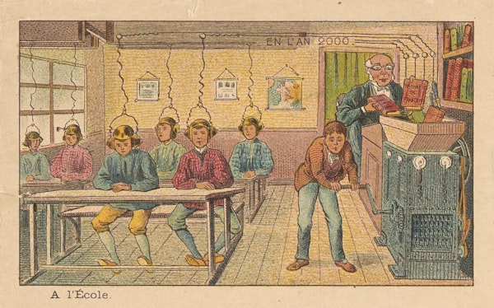
Notes:
Lost Futures: A 19th-Century Vision of the Year 2000
Jean-Marc Côté
https://publicdomainreview.org/collection/a-19th-century-vision-of-the-year-2000/

Slide 3
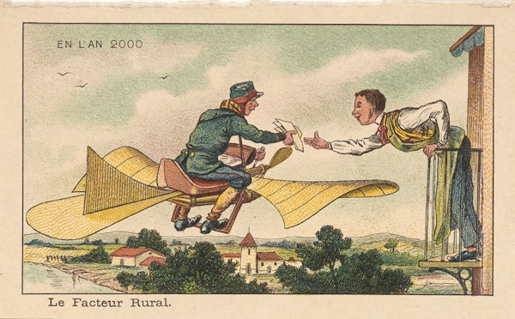
Notes:
Lost Futures: A 19th-Century Vision of the Year 2000
Jean-Marc Côté
https://publicdomainreview.org/collection/a-19th-century-vision-of-the-year-2000/

Slide 4
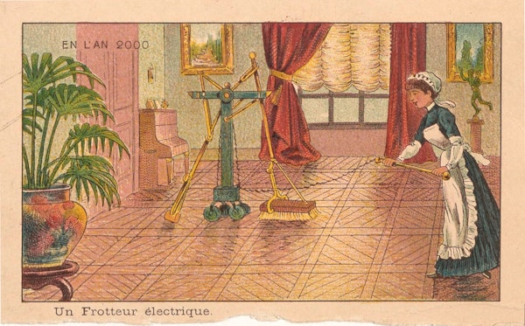
Notes:
Lost Futures: A 19th-Century Vision of the Year 2000
Jean-Marc Côté
https://publicdomainreview.org/collection/a-19th-century-vision-of-the-year-2000/

Slide 5
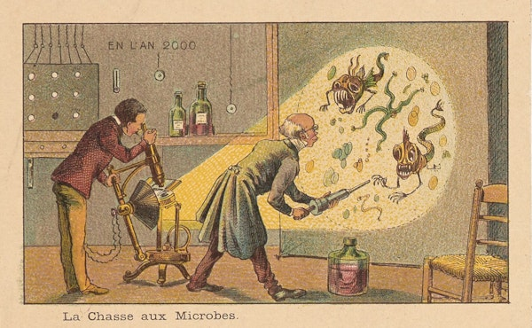
Notes:
Lost Futures: A 19th-Century Vision of the Year 2000
Jean-Marc Côté
https://publicdomainreview.org/collection/a-19th-century-vision-of-the-year-2000/

Slide 6
How might science be different in another 100 years…

Slide 7
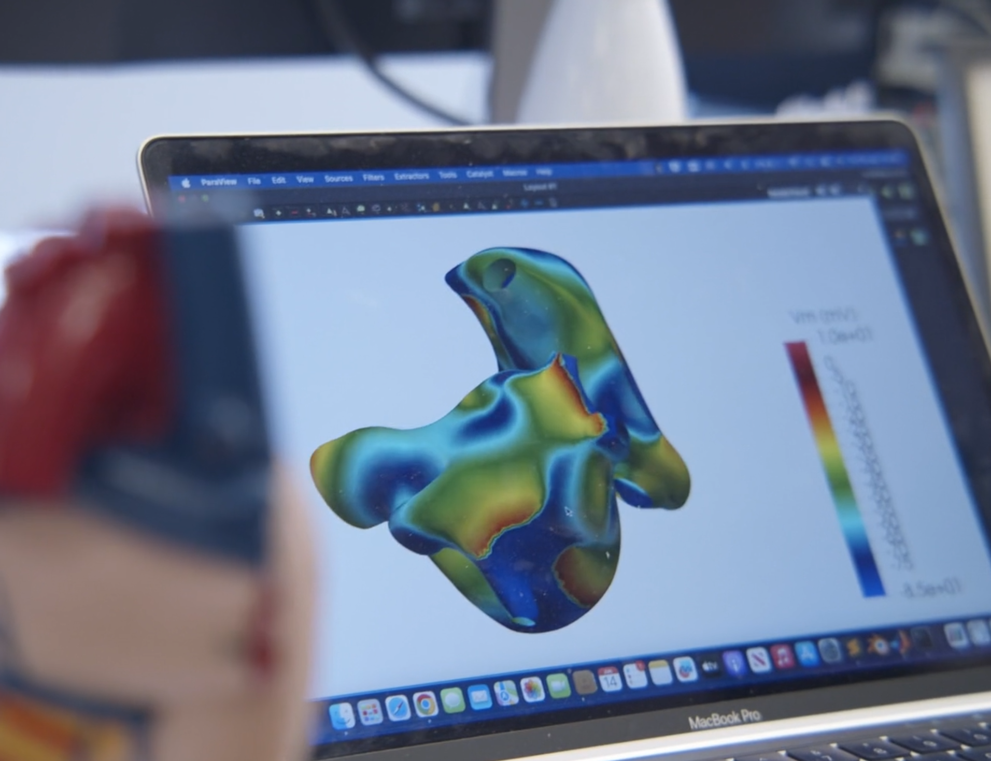
Evaluating the drug development process
Explain why drugs need to be tested
Describe the steps in the drug trial process and explain the reasons each step is needed
Evaluate different methods of testing new drugs

Slide 8
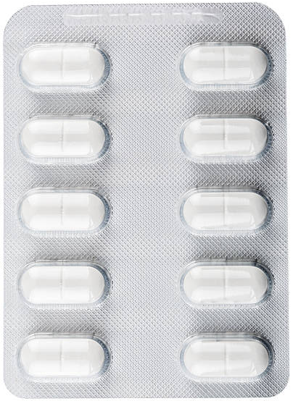
Safe for humans
Cheap
What do we need to know about new medicines before we give them to people?
Good branding
Effective
How new are they?
Colour
Is it safe for animals
Correct dose
Any side effects
Tastes nice
Notes:
Think, pair, shre.
Click each option: correct answers turn green, incorrect answers disappear.

Slide 9
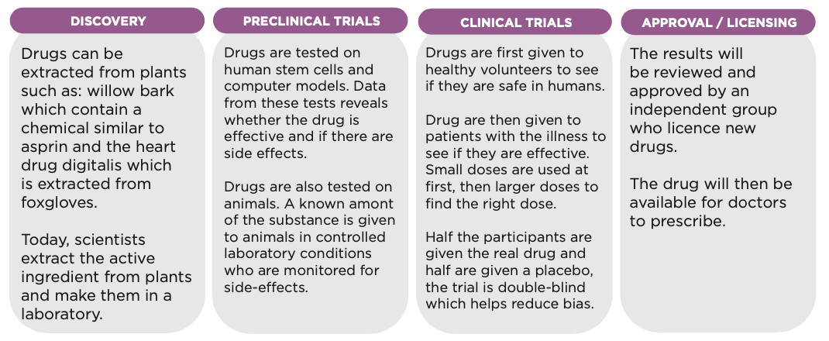
1. Use the diagram to find out how the process ensures:
a. Safety?
b. Efficacy?
c. Correct dose?
2. Read the text under the diagram and underline in two different colours the arguments FOR and AGAINST animal experiments.
Notes:
Insert graphic from ‘stages in drug development’ info sheet.

Slide 10
1. Use the diagram to find out how the process ensures:
a. Safety? Drugs are tested on human cells, computer models and animals before humans
b. Efficacy? Double-blind trial reduces bias during clinical trials
c. Correct dose? Small amounts given initially then gradually increased
2. Read the ‘Can we improve preclinical trials?’ text under the diagram and underline in two different colours the arguments FOR and AGAINST animal experiments.
Notes:
Insert graphic from ‘stages in drug development’ info sheet.

Slide 11
FOR | AGAINST
Allows us to see effects of drug in a living organism | Millions of animals are experimented on every year
Thought to reduce risk of side effects in humans | Results from animal experiments don’t always translate well to humans (due to differences between species at genetic and subcellular level)
Has been used for many decades so scientists and regulators understand and trust the data from these experiments | There are now human-relevant methods available which might lead to safer and more effective medicine

Slide 12
FUTURE OF SCIENCE FILM

Slide 13
Evaluate the following research methods:
Animal experiments
Humane research (including stem cells, computer modelling and organs-on-a-chip)
Consider the following:
Is the data human-relevant? i.e. Does it use human cells and data?
Can experiments accurately predict what will happen in a human?
Are there ethical issues?
How well-established is it?

Slide 14
Evaluate the following research methods:
Animal experiments
The data is not always relevant to humans and does not always accurately predict what will happen in humans. There is a significant ethical issue of whether it is justified to carry out painful experiments on sentient beings. This type of research has been used for decades and is very well-established.
b. Humane research (including stem cells, computer modelling and organs-on-a-chip)
This type of research uses data from human cells, tissues and organs so it is directly relevant to humans. It can give more reliable data than animal experiments. No sentient beings are experimented on, so the ethical issue is solved. This type of research has had relatively little money or time invested and would benefit from more resources.

Slide 15
Rank the cards in order of how important you think they are
Most
important
Joint 2nd
Joint 2nd
Joint 3rd
Joint 3rd
Joint 3rd
Joint 4th
Joint 4th
Extension: are these ethical, social or scientific factors (or a combination)? Suggest solutions to any of the problems.
Least
important

Slide 16
Experiments use sentient beings who feel pain and fear.
72% of the British public are against animal experiments.
Using human cells and data gives results which better predict what will happen in humans.
Differences between species mean drugs have different effects in different species.
Around 90% of drugs which pass preclinical trials on animals fail clinical trials on humans.
Animal experiments allow us to see how an entire living organism will respond to a drug.
Animal experiments have more resources (time and money) invested in them than humane research.
Using human cells and data could help lead to personalised medicine.
Many laboratories are already set up with equipment and staff trained to do animal experiments.
Notes:
To print for each student or pair of students

Slide 17
Think, pair, share:
Overall, do you think the benefits of animal experiments outweigh the problems? Explain why.

