Slide 1
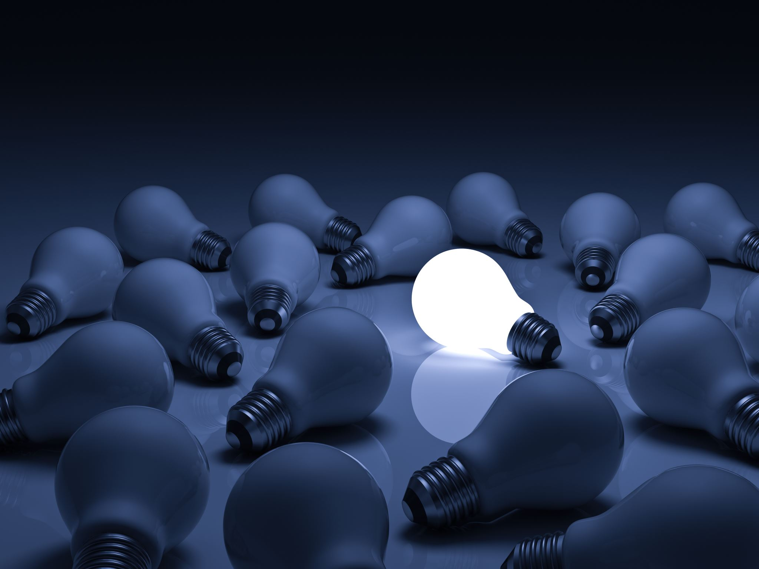
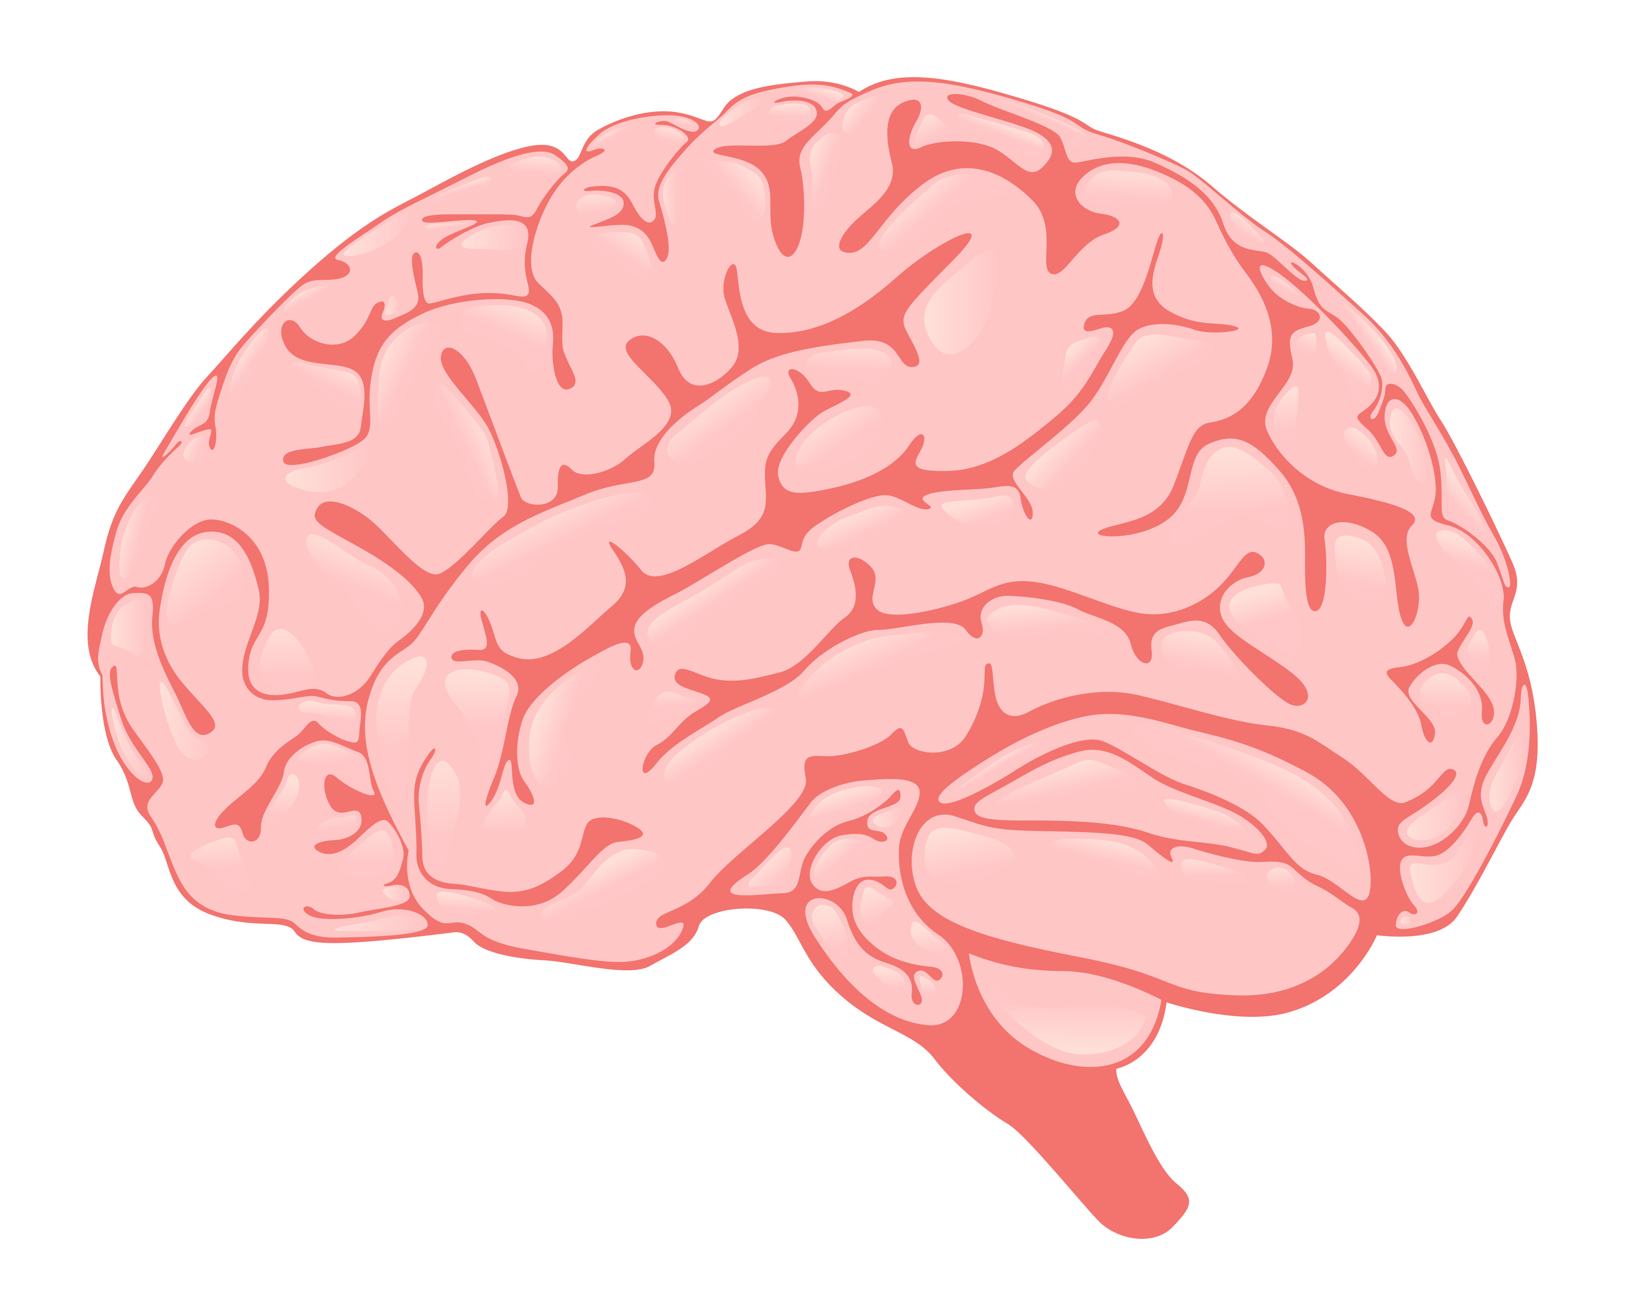
What are they talking about?
“There is no scientific study more vital to humans than the study of the _____. Our entire view of the universe depends on it.”
- Francis H.C. Crick
BRAIN
“Shaped a little like a loaf of French country bread, our _____ is a crowded chemistry lab, bustling with nonstop neural conversations.”
- Diane Ackerman
BRAIN
BRAIN
“I like nonsense; it wakes up the _____ cells.
- Dr. Seuss

Slide 2
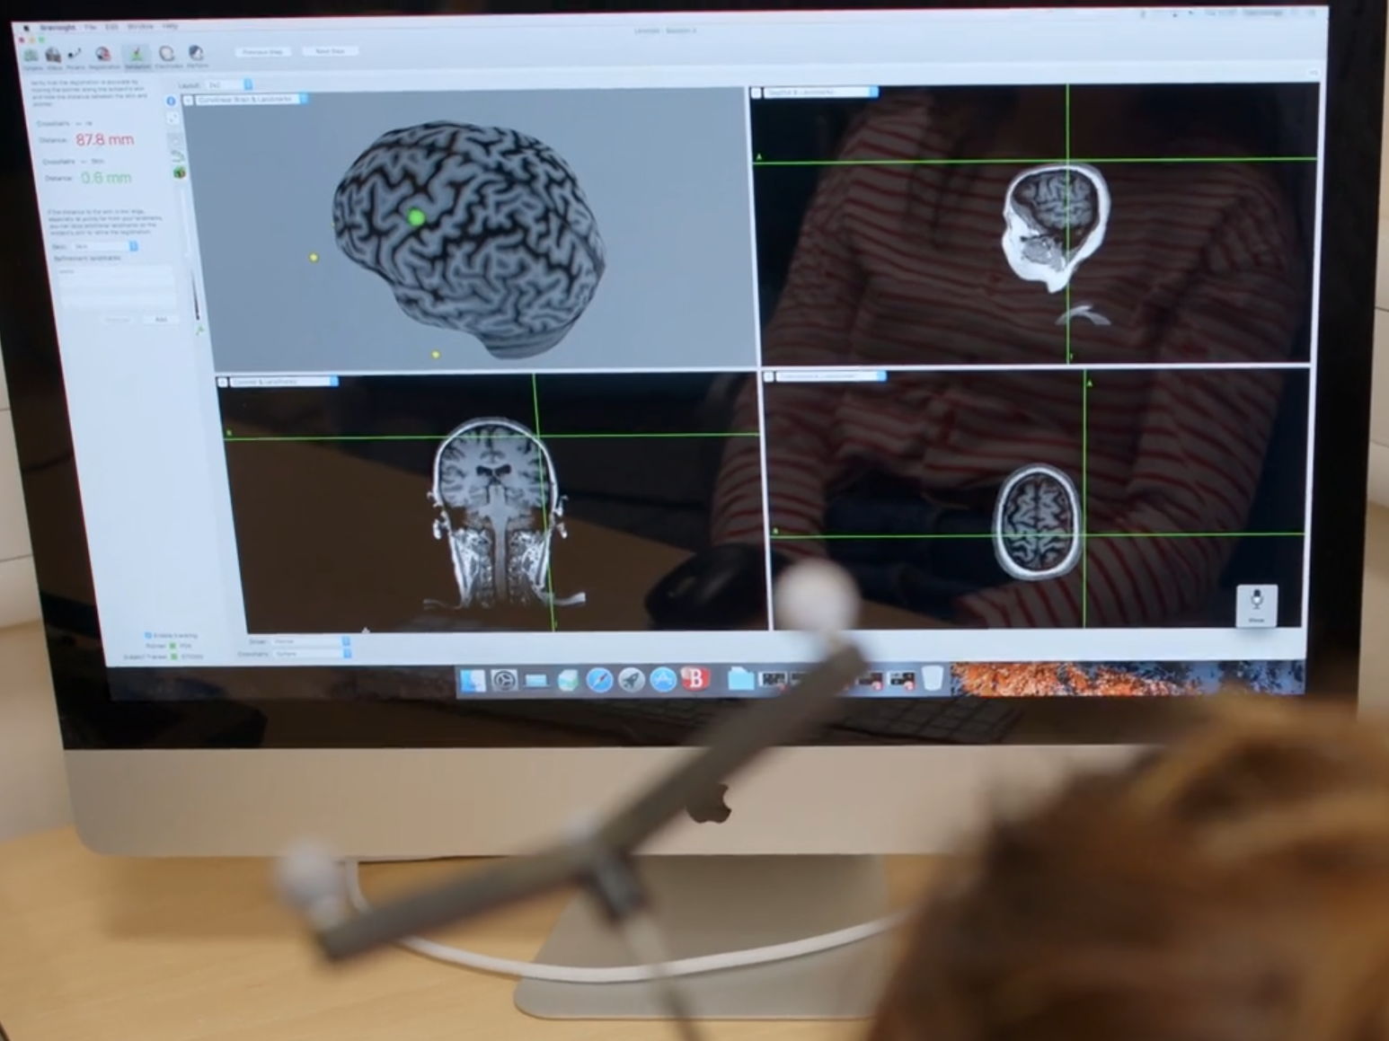
The Brain
Identify some areas of the brain and describe their function
Explain some of the difficulties of investigating brain function and treating brain damage/disease
Evaluate the benefits and risks of procedures carried out in the brain and nervous system.

Slide 3
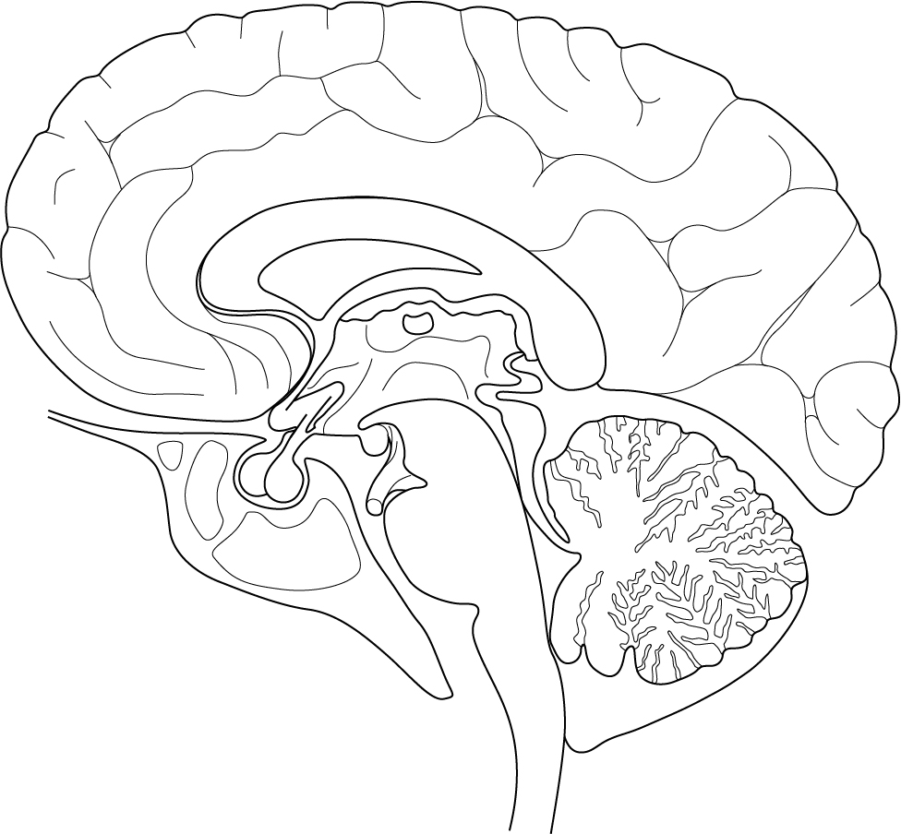
Areas of the brain
Cerebral cortex
The ‘thinking’ part of the brain which controls intelligence, personality, conscious thought and high-level functions, such as language and verbal memory.
Hypothalamus
Helps maintain homeostasis by regulating temperature and water balance in the body.
Medulla
Controls unconscious activities such as heart rate and breathing rate.
Cerebellum
Controls balance, co-ordination of movement and muscular activity.
Pituitary gland
Produces important hormones such as FS and FSH
Notes:
https://neuroscience-graphicdesign.com/

Slide 4
Notes:
Student handout
https://neuroscience-graphicdesign.com/

Slide 5
TMS FILM

Slide 6
Investigating the brain
Get into teams of four.
Label yourself A, B, C and D.
Sit with those who share the same letter as you.
Research your procedure using the information sheet. Describe how your procedure works and the benefits/problems in the relevant places on your table.
Return to your original team and pass in the information you have learned so that everybody’s table will be complete.
Extension: evaluate each procedure and decide which is/are the most important.

Slide 7
Procedure | How does it work? | What are the benefits? | What are the problems?
Animal experiments
Studying patients with brain damage
Electrical stimulation
Brain imaging
Notes:
Blank

Slide 8
Procedure | How does it work? | What are the benefits? | What are the problems?
Animal experiments | Animals have their brains __________ (lesioned). This can involve starving areas of oxygen or applying chemicals to kill brain cells. Scientists then observe how the damage affects the animal’s behaviour, movement or memory. When the experiment is finished, the animals are killed. | Scientists can target __________ areas of the animal brain to see what effect this has. | Animal brains are very different to human brains, so the results do not always apply to people. Studying animals can’t tell us about things that are unique to humans such as complex __________. The ethical issue of causing pain and suffering to animals.
Studying patients with brain damage | Patients with brain damage can be observed to see what changes occur in their behaviour, memory or abilities. We can use brain __________ to find out which area of the brain is damaged and observe what happens when that area does not function the way it should. | The results of these observations are __________, so they reveal things about how the human brain functions. | We rely on _________ or injuries so cannot target specific areas. We can only study atypical, damaged or diseased brains.
Electrical stimulation | Stimulation causes __________ activity in specific areas of the brain. Stimulating different areas results in different __________. For examples, if the motor area is stimulated, the patient makes an involuntary __________. | Brief, _________ and safe. Allows us to study typical or atypical brains. Using brain imaging we can stimulate specific areas of the brain. | Can cause mild discomfort during process.
Brain imaging | MRI scans use magnetic fields and radio waves to produce detailed __________ of brain. CT scans fire x-rays from different angles at the brain to build up a picture of it. PET scans: Use a small amount of radioactive material to track activity in the brain and show how it is functioning. | Can be used to diagnose or monitor brain __________. Non-invasive. Safe. | Radio waves can __________ the body if exposed for too long.
Word bank: responses, language, damaged, specific, disease, imaging, movement, accidents, image, heat, electrical, human-relevant, reversible
Notes:
CLOZE

Slide 9
Procedure | How does it work? | What are the benefits? | What are the problems?
Animal experiments | Animals have their brains d__________ (lesioned). This can involve starving areas of oxygen or applying chemicals to kill brain cells. Scientists then observe how the damage affects the animal’s behaviour, movement or memory. When the experiment is finished, the animals are killed. | Scientists can target s__________ areas of the animal brain to see what effect this has. | Animal brains are very different to human brains, so the results do not always apply to people. Studying animals can’t tell us about things that are unique to humans such as complex l__________. The ethical issue of causing pain and suffering to animals.
Studying patients with brain damage | Patients with brain damage can be observed to see what changes occur in their behaviour, memory or abilities. We can use brain i__________ to find out which area of the brain is damaged and observe what happens when that area does not function the way it should. | The results of these observations are h__________, so they reveal things about how the human brain functions. | We rely on a__________ or injuries so cannot target specific areas. We can only study atypical, damaged or diseased brains.
Electrical stimulation | Stimulation causes e__________ activity in specific areas of the brain. Stimulating different areas results in different r__________. For examples, if the motor area is stimulated, the patient makes an involuntary m__________. | Brief, r_________ and safe. Allows us to study typical or atypical brains. Using brain imaging we can stimulate specific areas of the brain. | Can cause mild discomfort during process.
Brain imaging | MRI scans use magnetic fields and radio waves to produce detailed i__________ of brain. CT scans fire x-rays from different angles at the brain to build up a picture of it. PET scans: Use a small amount of radioactive material to track activity in the brain and show how it is functioning. | Can be used to diagnose or monitor brain d__________. Non-invasive. Safe. | Radio waves can h__________ the body if exposed for too long.
Word bank: responses, language, damaged, specific, disease, imaging, movement, accidents, image, heat, electrical, human-relevant, reversible
Notes:
CLOZE with support

Slide 10
Procedure | How does it work? | What are the benefits? | What are the problems?
Animal experiments | Animals have their brains damaged (lesioned). This can involve starving areas of oxygen or applying chemicals to kill brain cells. Scientists then observe how the damage affects the animal’s behaviour, movement or memory. When the experiment is finished, the animals are killed. | Scientists can target specific areas of the animal brain to see what effect this has. | Animal brains are very different to human brains, so the results do not always apply to people. Studying animals can’t tell us about things that are unique to humans such as complex language. The ethical issue of causing pain and suffering to animals
Studying patients with brain damage | Patients with brain damage can be observed to see what changes occur in their behaviour, memory or abilities. We can use brain imaging to find out which area of the brain is damaged and observe what happens when that area does not function the way it should. | The results of these observations are human-relevant, so they reveal things about how the human brain functions. | We rely on accidents or injuries so cannot target specific areas. We can only study atypical, damaged or diseased brains.
Electrical stimulation | Stimulation causes electrical activity in specific areas of the brain. Stimulating different areas results in different responses. For examples, if the motor area is stimulated, the patient makes an involuntary movement. | Brief, reversible and safe. Allows us to study typical or atypical brains. Using brain imaging we can stimulate specific areas of the brain. | Can cause mild discomfort during process.
Brain imaging | MRI scans use magnetic fields and radio waves to produce detailed image of brain. CT scans fire x-rays from different angles at the brain to build up a picture of it. PET scans: Use a small amount of radioactive material to track activity in the brain and show how it is functioning. | Can be used to diagnose or monitor brain disease. Non-invasive. Safe. | Radio waves can heat the body if exposed for too long.
Notes:
Answers

Slide 11
Which procedures would be most useful in the following situations:
All
Most
Some
Patient A fell from a height and hit their head. How could you find out which part and how badly their brain is damaged?
Patient B suffered a head injury last year and has noticed that they can no longer sing in tune. How could you use this case to discover more about the structure of the human brain?
Patient C has Motor Neurone Disease. This means electrical impulses from motor neurons gradually stop reaching the muscles. How could you find out how far a nerve impulse gets before it degrades?
Brain imaging such as MRI or CT scan.
Use an MRI or CT scan to locate the damaged area. The area which is damaged likely plays a role in singing in tune.
Use electrical stimulation such as TMS to produce an electrical impulse in the brain. Then place electrodes along the body to detect when the signal degrades.
Extension:
Do you think animal experiments could help us answer the above questions?

Slide 12
If you had £10 billion to find out more about the brain, how would you invest the money?
Explain why you would invest in some procedures, but not others.

