Slide 1
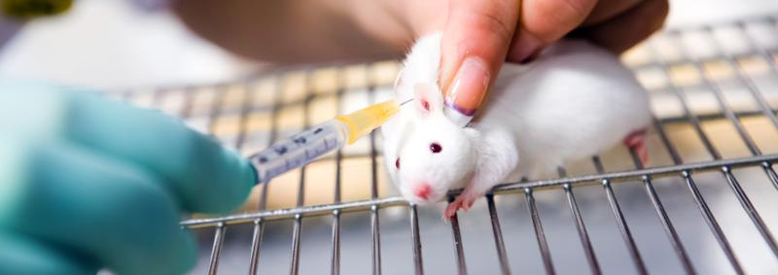
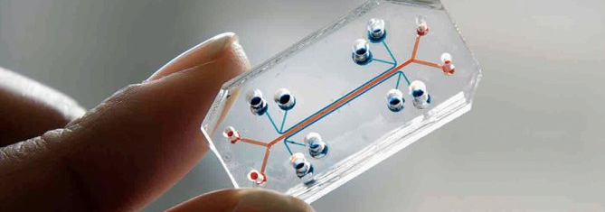
Agree or disagree?
Animal experiments cause animals to suffer.
Animal experiments are necessary to find treatments for human diseases.
It is wrong to experiment on animals.
How might these people respond to these questions?
A scientist who conducts animal experiments
A scientist who conducts animal-free research

Slide 2
VOTE 1
Should we continue to fund animal experiments to find treatments for human disease?
Yes
Not sure
No

Slide 3
Should we invest more resources into humane research rather than animal experiments?
Should we invest more resources into humane research rather than animal experiments?
Yes
Not sure
No
Yes
Not sure
No
Should we invest more resources into humane research rather than animal experiments?
Should we invest more resources into humane research rather than animal experiments?
Yes
Not sure
No
Yes
Not sure
No
Notes:
To print

Slide 4
Scientist who conducts animal research
We need to use animals to understand the causes of and treatments for human diseases.
Animals are used when there is a need to find out what happens in a whole living organism.
Testing new drugs on animals means we can predict if the drug can be safely given to humans.
Our animals are well taken care of and do not suffer more than they need to.
Notes:
To print

Slide 5
Scientist who conducts humane research
Though we share some similarities with other animals, there are vast differences at the subcellular and genetic level. This means experiments on animals are poor indicators of what will happen in humans.
Other animals don’t suffer the same diseases as humans do and drugs affect them differently too.
Using human-relevant methods such as stem cells, organ-on-a-chip and computer modelling to test new drugs will result in better, safer medicine.

Slide 6
A patient
I don’t like the idea of animals suffering but we need safe and effective treatments for diseases. Animal experiments are the price we must pay for this.
Mice and rats are less intelligent than humans and we are more important than other animals.
We’ve been experimenting on animals for hundreds of years and this is the reason we live longer today.
Notes:
To print

Slide 7
A doctor
Many people believe we are living longer because of animal experiments but this is mostly thanks to improvements in nutrition, vaccines and antibiotics.
Lots of time and money has been spent on animal experiments for diseases that we still have no effective treatments for, for example Alzheimer’s.
Some drugs pass trials in animals but are found to be unsafe in humans. Thalidomide was found to be “safe” when tested in mice, rats, guinea-pigs and rabbits, but caused deformities in thousands of humans. We need to find better, safer ways to test new drugs.
Notes:
To print

Slide 8
A politician
A recent poll showed 72% of the British public want to see animal experiments phased out. This government supports this policy and will work towards a plan to end animal experiments within the next 50 years.
If we end animal experiments abruptly, we could do more harm than good. We must be cautious and do things in the right way.
Currently many of our biomedical laboratories have the equipment and staff for animal experiments. It is not easy or cheap to switch to humane methods.
Notes:
To print

Slide 9
Animal rights organisation
Around 3 million animals are used in experiments every year in the UK. Tens of thousands of these are classified as causing “severe” suffering.
The animals – mice, rats, cats, dogs, monkeys - used in experiments can feel pain and fear, just like the companion animals we share our homes with.
Animal welfare laws do not apply to animals used in laboratories. Animal experiments are shrouded in secrecy to stop people finding out how much these animals suffer.
Notes:
To print

Slide 10
Evidence A: Future of Science film

Slide 11
Evidence B: Animal Experiments: pain, production and playing god (5.12 – 9.08):
Notes:
https://youtu.be/7d84zKc7mFk?si=S5gLBfFR2wRseV2_&t=312

Slide 12
Evidence C: Government statistics scientific procedures involving living animals in Great Britain in 2023
More than 2.68 million procedures were carried out
More than 80,000 of the procedures were categorised as causing ’severe’ suffering
The majority (95%) of procedures used mice, fish, birds or rats
32,160 procedures were carried out on cats, dogs, horses and non-human primates
Notes:
https://www.gov.uk/government/statistics/statistics-of-scientific-procedures-on-living-animals-great-britain-2023/annual-statistics-of-scientific-procedures-on-living-animals-great-britain-2023

Slide 13
VOTE 2
Should we continue to fund animal experiments to find treatments for human disease?
Yes
Not sure
No

Slide 14
Did your answers change? Why/why not? Are you more confident or less confident in your beliefs now? What could you do with what you’ve learned?

